Slide 1


Department of CSE
Deep Learning
20CS3269AA
Topic:
Feed forward Neural Network
Session - 4

Slide 2
AIM OF THE SESSION
To familiarize students with the concept of Feed forward Neural Network
INSTRUCTIONAL OBJECTIVES
This Session is designed to:
Demonstrate the working of feed forward network
Solve back propogation of a neural network
LEARNING OUTCOMES
At the end of this session, you should be able to:
Able to solve neural network using back propogation

Slide 3
Index
Need of Feed forward Neural Network
Back Propagation
Solve Backpropagation

Slide 4
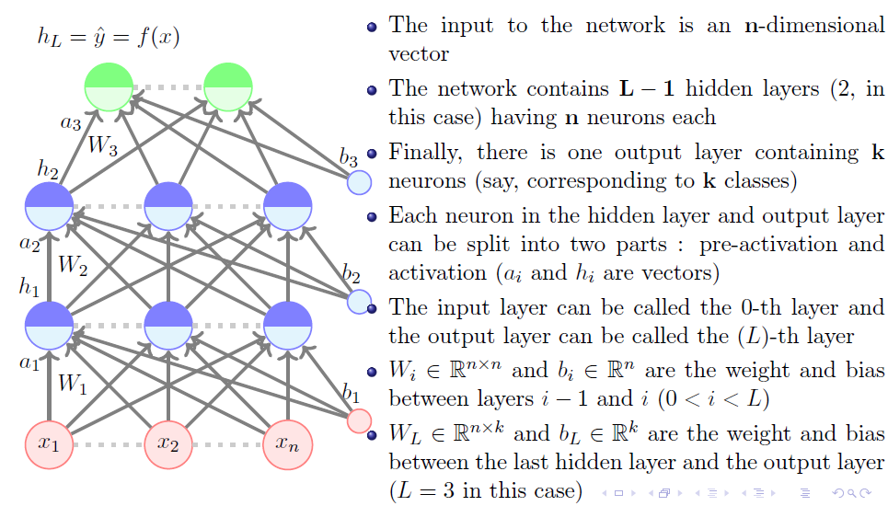
Feed Forward Neural Networks

Slide 5
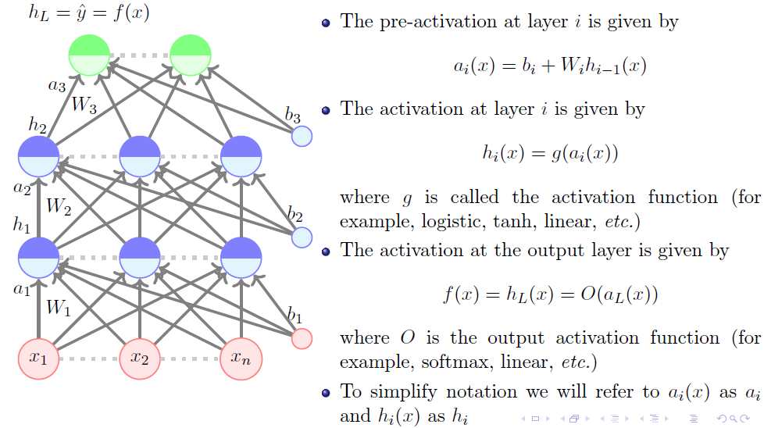
Feed Forward Neural Networks (Cont..)

Slide 6
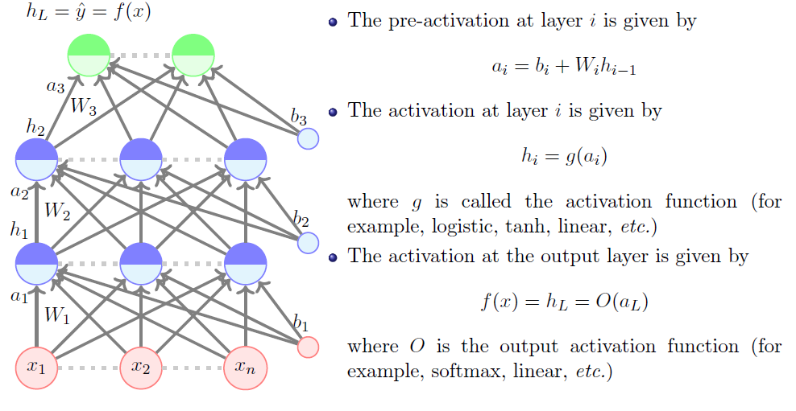
Feed Forward Neural Networks (Cont..)

Slide 7
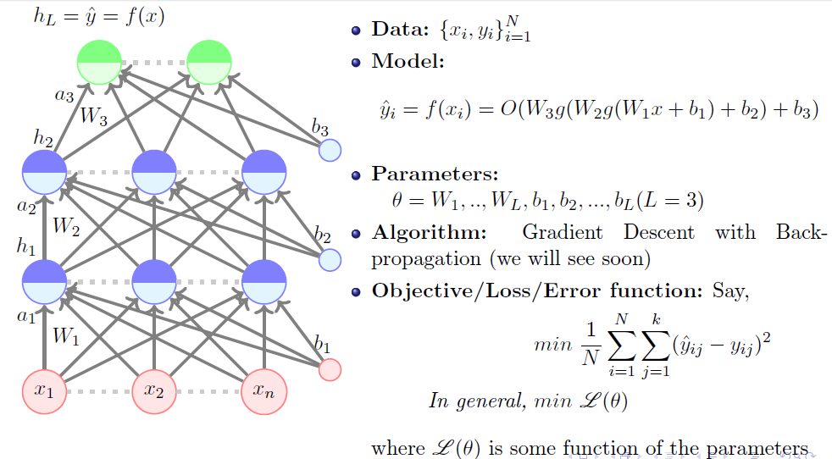
Feed Forward Neural Networks (Cont..)

Slide 8
Back Propagation Network
Back Propagation Preparation
Training Set: A collection of input-output patterns that are used to train the network
Testing Set: A collection of input-output patterns that are used to assess network performance
Learning Rate-η: A scalar parameter, analogous to step size in numerical integration, used to set the rate of adjustments

Slide 9
Network Error
Total-Sum-Squared-Error (TSSE)
Root-Mean-Squared-Error (RMSE)

Slide 10
A Pseudo-Code Algorithm
Initialize weights randomly ➤ All connections (input → hidden, hidden → output) are assigned small random
weights.
Repeat until error is small enough:
For each training input pattern:
🔹 Apply inputs to the input layer
🔹 Feedforward: Compute outputs for hidden and output layers
🔹 Calculate error at the output layer (Target − Output)
🔹 Backpropagate error:
Compute error signals for hidden and output neurons
Update all weights using gradient descent
Occasionally check if total error has reduced enough

Slide 11
Possible Data Structures
Two-dimensional arrays
Weights (at least for input-to-hidden layer and hidden-to-output layer connections)
Weight changes (Δ_{ij})
One-dimensional arrays
Neuron layers
Cumulative current input
Current output
Error signal for each neuron
Bias weights

Slide 12
Apply Inputs From A Pattern
Apply the value of each input parameter to each input node
Input nodes compute only the identity function
Feedforward
Calculate Outputs For Each Neuron Based On The Pattern
The output from neuron j for pattern p is Opj where
and
k ranges over the input indices and Wkj is the weight on the connection from input k to neuron j
Inputs
Outputs

Slide 13
Calculate The Error Signal For Each Output Neuron
The output neuron error signal δ_{pj} is given by δ_{pj}=(T_{pj}-O_{pj}) O_{pj} (1-O_{pj})
T_{pj} is the target value of output neuron j for pattern p
O_{pj} is the actual output value of output neuron j for pattern p

Slide 14
Calculate The Error Signal For Each Hidden Neuron
The hidden neuron error signal δ_{pj} is given by
where δ_{pk} is the error signal of a post-synaptic neuron k and W_{kj} is the weight of the connection from hidden neuron j to the post-synaptic neuron k

Slide 15
Calculate And Apply Weight Adjustments
Compute weight adjustments ΔW_{ji} at time t by ΔW_{ji}(t)= η δ_{pj} O_{pi}
Apply weight adjustments according to W_{ji}(t+1) = W_{ji}(t) + α∗ ΔW_{ji}(t)

Slide 16
An Example: Exclusive “OR”
Training set
((0.1, 0.1), 0.1)
((0.1, 0.9), 0.9)
((0.9, 0.1), 0.9)
((0.9, 0.9), 0.1)
Testing set
Use at least 121 pairs equally spaced on the unit square and plot the results
Omit the training set (if desired)

Slide 17
An Example (continued): Network Architecture
inputs
output(s)

Slide 18
An Example (continued): Network Architecture
Target output
0.9
0.1
Sample input
1
0.9
1
1

Slide 19
Feedforward Network Training by Backpropagation: Process Summary
Select an architecture
Randomly initialize weights
While error is too large
Select training pattern and feedforward to find actual network output
Calculate errors and backpropagate error signals
Adjust weights
Evaluate performance using the test set

Slide 20
An Example (continued): Network Architecture
??
Actual output
???
Target output
0.9
0.1
??
Sample input
??
??
1
??
??
0.9
??
1
??
??
1

Slide 21
Gradient Descent
Gradient Descent Learning Rule
Consider linear unit without threshold and continuous output o (not just –1,1)
o=w₀ + w₁ x₁ + … + w_{n} x_{n}
Train the w_{i}’s such that they minimize the squared error
E[w₁,…,w_{n}] = ½ Σ_{d∈D} (t_{d}-o_{d})²
where D is the set of training examples

Slide 22
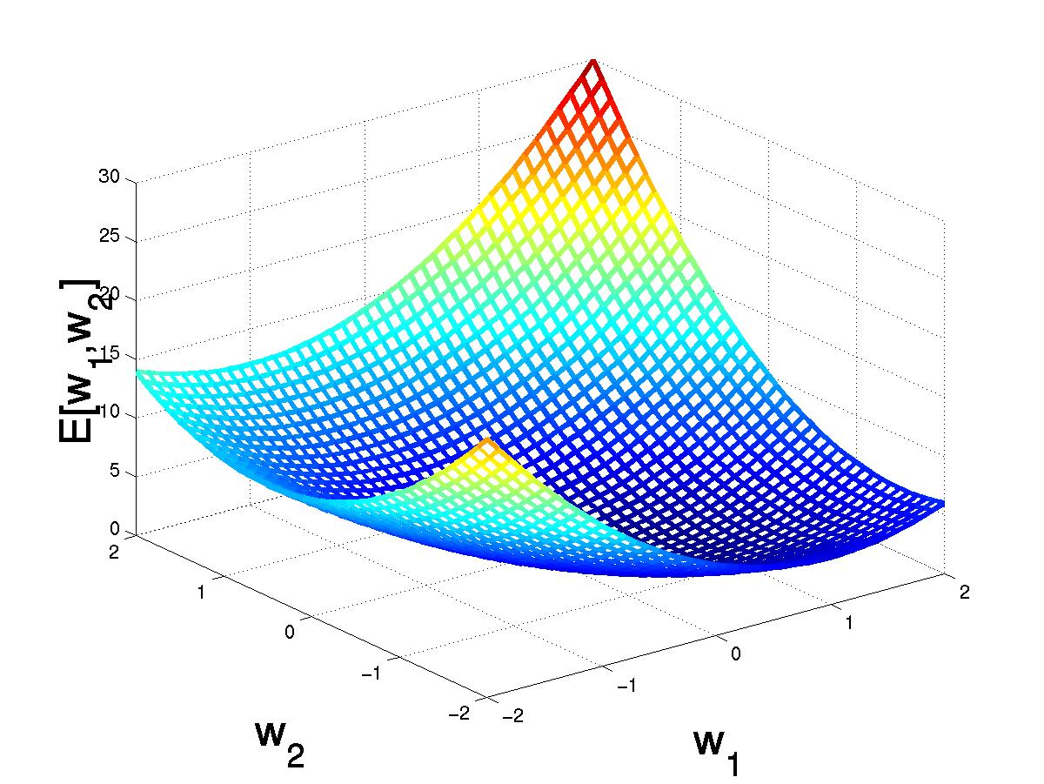
Gradient Descent
D={<(1,1),1>,<(-1,-1),1>,
<(1,-1),-1>,<(-1,1),-1>}
(w₁,w₂)
Gradient:
∇E[w]=[∂E/∂w₀,… ∂E/∂w_{n}]
Δw=-η ∇E[w]
(w₁+Δw₁,w₂ +Δw₂)
Δw_{i}=-η ∂E/∂w_{i}
=∂/∂w_{i} 1/2Σ_{d}(t_{d}-o_{d})²
= ∂/∂w_{i} 1/2Σ_{d}(t_{d}-Σ_{i} w_{i} x_{i})²
= Σ_{d}(t_{d}- o_{d})(-x_{i})

Slide 23
Gradient Descent
Gradient-Descent(training_examples, η)
Each training example is a pair of the form <(x₁,…x_{n}),t> where (x₁,…,x_{n}) is the vector of input values, and t is the target output value, η is the learning rate (e.g. 0.1)
Initialize each w_{i} to some small random value
Until the termination condition is met, Do
Initialize each Δw_{i} to zero
For each <(x₁,…x_{n}),t> in training_examples Do
Input the instance (x₁,…,x_{n}) to the linear unit and compute the output o
For each linear unit weight w_{i} Do
Δw_{i}= Δw_{i} + η (t-o) x_{i}
For each linear unit weight wi Do
w_{i}=w_{i}+Δw_{i}

Slide 24
Comparison Perceptron and Gradient Descent Rule
Perceptron learning rule guaranteed to succeed if
Training examples are linearly separable
Sufficiently small learning rate η
Linear unit training rules uses gradient descent
Guaranteed to converge to hypothesis with minimum squared error
Given sufficiently small learning rate η
Even when training data contains noise
Even when training data not separable by H

Slide 25
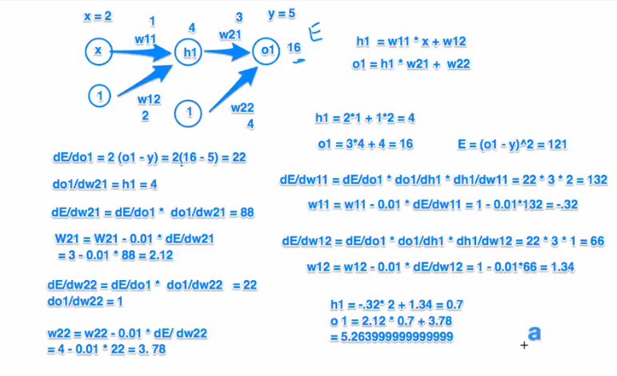
Example of Gradient Descent

Slide 26
SELF-ASSESSMENT QUESTIONS
What is the objective of backpropagation algorithm?
to develop learning algorithm for multilayer feedforward neural network
to develop learning algorithm for single layer feedforward neural network
to develop learning algorithm for multilayer feedforward neural network, so that network can be trained to capture the mapping implicitly
none of the
2. What are the general tasks that are performed with backpropagation algorithm?
pattern mapping
function approximation
prediction
all of the mentioned

Slide 27
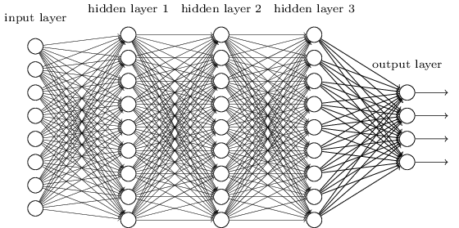
TERMINAL QUESTIONS
1. There is a two-dimensional input x=(x1,x2) and two parameters w=(w1,w2) to implement the function f(x,w)=σ(σ(x1w1)w2+x2) where σ(x)=1/(1+e−x)) .
The network uses backpropagation to estimate the right parameter values. Initialize parameters as zero. If input x1 = 1, x2 = 0, and output y = 5 what is the value of ∂f/∂w2 .
Summarize Back Propagation
Identify the need Gradient Descent
Write down the weight and bias matrix sizes of the each layer in the below network

Slide 28
REFERENCES FOR FURTHER LEARNING OF THE SESSION
Books:
1 Ian Goodfellow and Yoshua Bengio and Aaron Courville (2016) Deep Learning Book
Sites and Web links:
1.https://www.youtube.com/watch?v=X4RmokyD3U8&list=PLyqSpQzTE6M9gCgajvQbc68Hk_JKGBAYT&index=19
2. https://towardsdatascience.com/mcculloch-pitts-model-5fdf65ac5dd1
3. https://medium.datadriveninvestor.com/mp-neuron-and-perceptron-98abbd542e47

